Slide 1
Naïve Bayes Classifiers
CSC4232: Machine Learning
Lecturer No: |  | Week No: |  | Semester:
Instructor: | Md Saef Ullah Miah (saef@aiub.edu)

Slide 2
Naïve Bayes
Naive Bayes is a probabilistic algorithm that is based on Bayes' theorem.
It is commonly used for classification tasks and is particularly suited for text classification problems.
The "naive" assumption in Naive Bayes is that features are conditionally independent given the class label.

Slide 3
Bayesian Classifier
A statistical classifier:
performs probabilistic prediction, i.e., predicts class membership probabilities
Foundation:
Based on Bayes’ Theorem.
Performance:
A basic Bayesian classifier, naïve Bayesian classifier, has comparable performance with decision tree and selected neural network classifiers
Standard:
Even when Bayesian methods are computationally intractable, they can provide a standard of optimal decision making against which other methods can be measured

Slide 4
Bayes’ Theorem: Basics
Bayes’ Theorem:
Let X be a data sample (“evidence”): class label is unknown
Let H be a hypothesis that X belongs to class C
Classification is to determine P(H|X), (i.e., posteriori probability): the probability that the hypothesis holds given the observed data sample X
P(H) (prior probability): the initial probability
E.g., X will buy computer, regardless of age, income, …
P(X): probability that sample data is observed
P(X|H) (likelihood): the probability of observing the sample X, given that the hypothesis holds
E.g., Given that X will buy computer, the prob. that X is 31..40, medium income

Slide 5
Prediction Based on Bayes’ Theorem
Given training data X, posteriori probability of a hypothesis H, P(H|X), follows the Bayes’ theorem
Informally, this can be viewed as
posteriori = likelihood x prior/evidence
Predicts X belongs to C_{i} iff the probability P(C_{i}|X) is the highest among all the P(C_{k}|X) for all the k classes
Practical difficulty: It requires initial knowledge of many probabilities, involving significant computational cost

Slide 6
Classification Is to Derive the Maximum Posteriori
Let D be a training set of tuples and their associated class labels, and each tuple is represented by an n-D attribute vector X = (x₁, x₂, …, x_{n})
Suppose there are m classes C₁, C₂, …, C_{m}.
Classification is to derive the maximum posteriori, i.e., the maximal P(C_{i}|X)
This can be derived from Bayes’ theorem
Since P(X) is constant for all classes, only
needs to be maximized

Slide 7
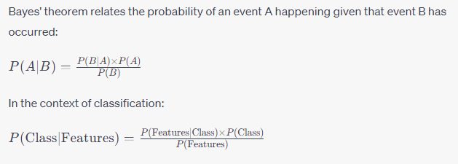
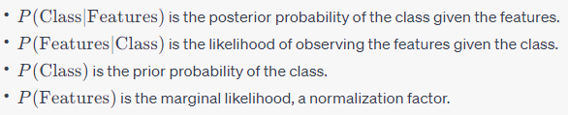
Step 1: Understanding Bayes' Theorem

Slide 8

Step 2: Naive Assumption
Naive Bayes assumes that the features (variables) are conditionally independent given the class label:

Slide 9
Step 3: Training the Model
Calculate Class Priors (P(Class)):
Count the occurrences of each class in the training data and divide by the total number of samples to get the prior probabilities for each class.
Calculate Likelihoods (P(Feature | Class)):
For each feature, calculate the probability of that feature occurring given each class. This is done by counting the occurrences of the feature within each class and dividing by the total number of samples in that class.
Calculate Marginal Likelihood (P(Features)):
This is a normalization factor and can be calculated as the sum of the products of class priors and likelihoods for all classes:

Slide 10
Step 4: Making Predictions
Given new features, calculate the probability of each class and choose the class with the highest probability as the predicted class.

Slide 11
Example:
Let's consider a binary classification problem: spam or not spam (ham) emails. We have two features:
Contains the word "lottery" (Feature 1)
Contains the word "win" (Feature 2)
Training Data:
Total emails: 1000
Spam emails: 300
Ham emails: 700
Spam emails containing "lottery": 250
Spam emails containing "win": 200
Ham emails containing "lottery": 50
Ham emails containing "win": 100

Slide 12

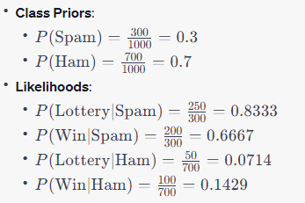
Example:
Training the Model

Slide 13

Example:
Making Predictions
Given new email with "lottery" and "win":
The email is classified as Spam because P(Spam∣Lottery,Win) is higher.

Slide 14
Variations of Naïve Bayes
Gaussian Naive Bayes: gaussiannb is used in classification tasks and it assumes that feature values follow a gaussian distribution.
Multinomial Naive Bayes: It is used for discrete counts.
Bernoulli Naive Bayes: The binomial model is useful if the feature vectors are boolean (i.e. zeros and ones).
Complement Naive Bayes: It is an adaptation of Multinomial NB where the complement of each class is used to calculate the model weights.
Categorical Naive Bayes: Categorical Naive Bayes is useful if the features are categorically distributed.

Slide 15
Naïve Bayes Classifier: Comments
Advantages
Easy to implement
Good results obtained in most of the cases
Disadvantages
Assumption: class conditional independence, therefore loss of accuracy
Practically, dependencies exist among variables
E.g., hospitals: patients: Profile: age, family history, etc.
Symptoms: fever, cough etc., Disease: lung cancer, diabetes, etc.
Dependencies among these cannot be modeled by Naïve Bayes Classifier

Slide 16
More On Naïve Bayes
Bayes theorem, the geometry of changing beliefs
https://www.youtube.com/watch?v=HZGCoVF3YvM&ab_channel=3Blue1Brown
https://www.kdnuggets.com/2020/06/naive-bayes-algorithm-everything.html

